Slide 1

Jeff Remley BS in Computer Science and Accounting
Josh Rosenzweig BS in Computer Science
Aliya Gangji BS in Computer Science and Spanish
Berg Health
Jorge Reyes Silveyra ‌ Assistant Professor of Computer Science
Technical Presentation February 22, 2017

Slide 2
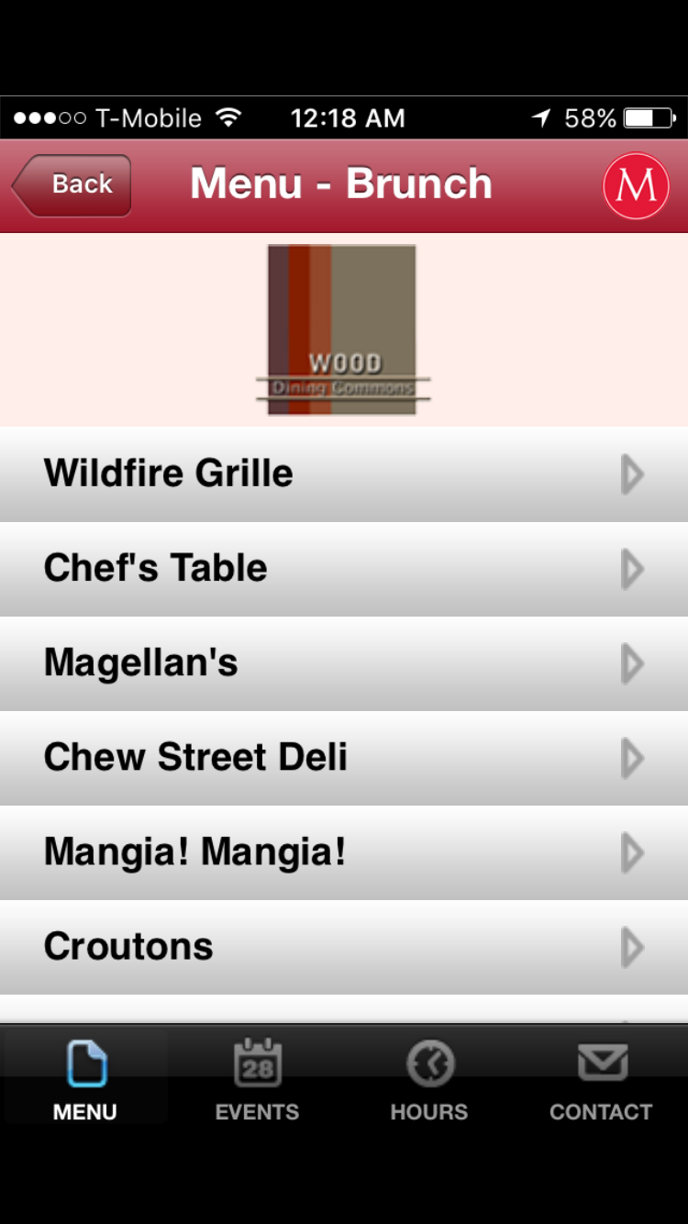
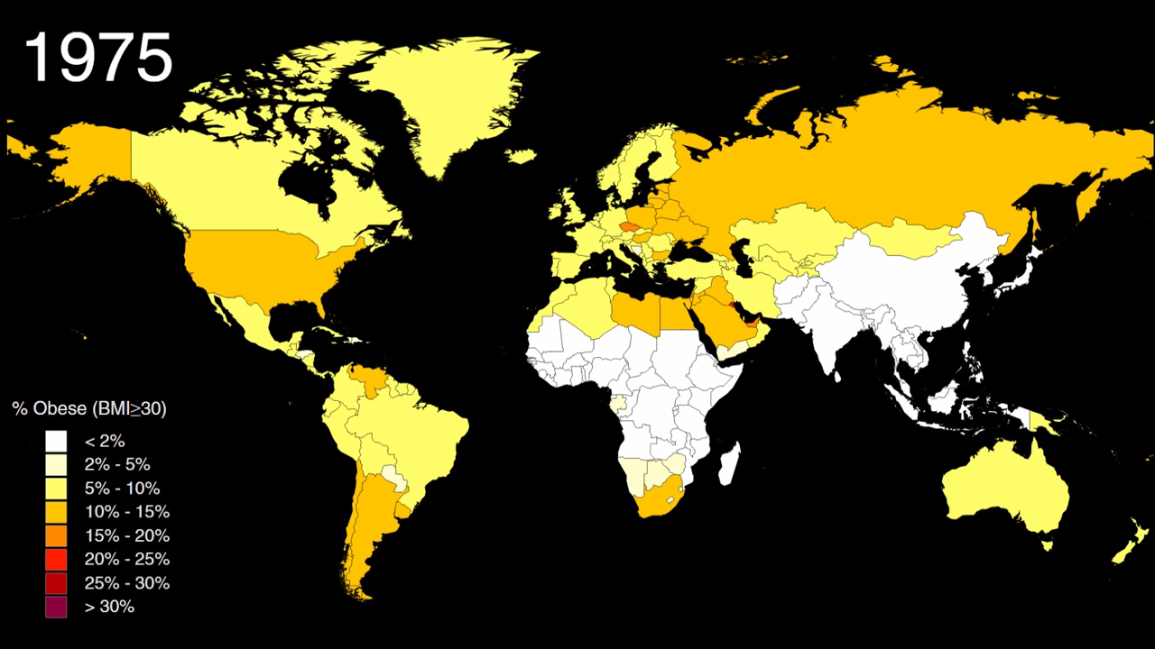
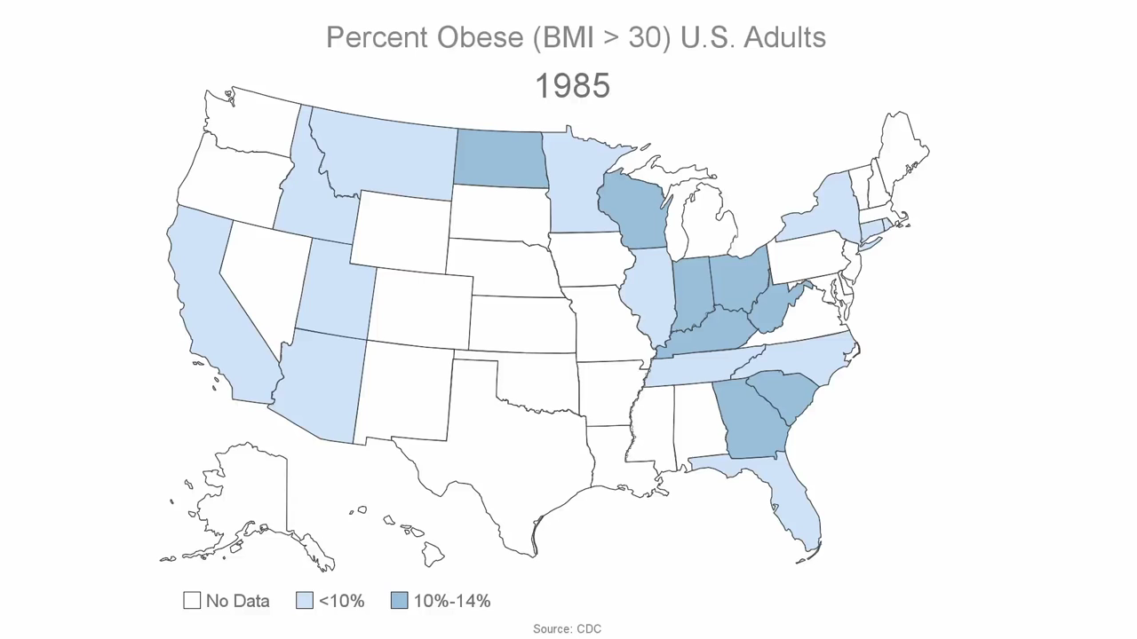
Project Motivation

Slide 3
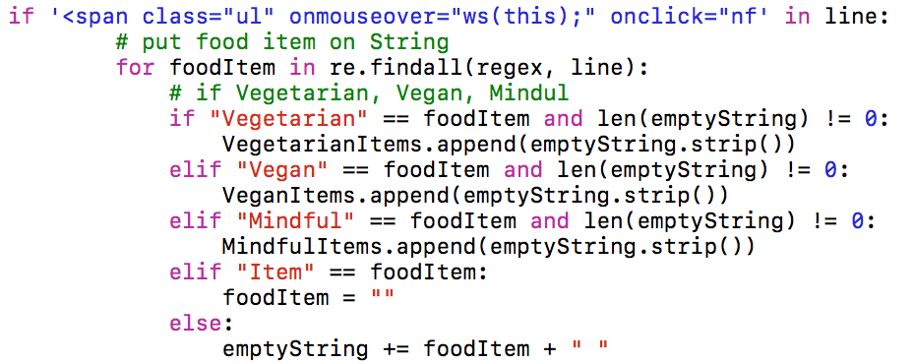
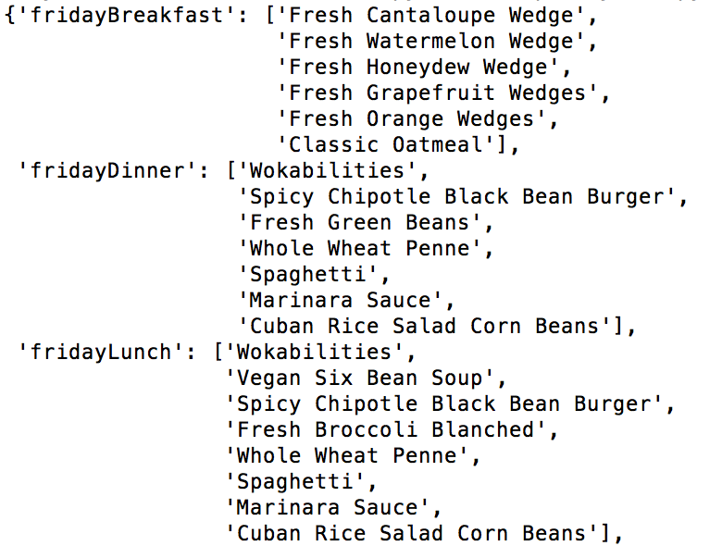
Berg Health
Vegetarian
Vegan
Gluten-Free
No Pork
Cheese, Milk

Slide 4
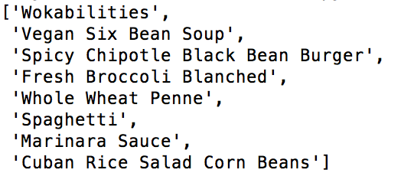
allVeganItems
fridayBreakfast
fridayLunch
fridayDinner
…

Slide 5
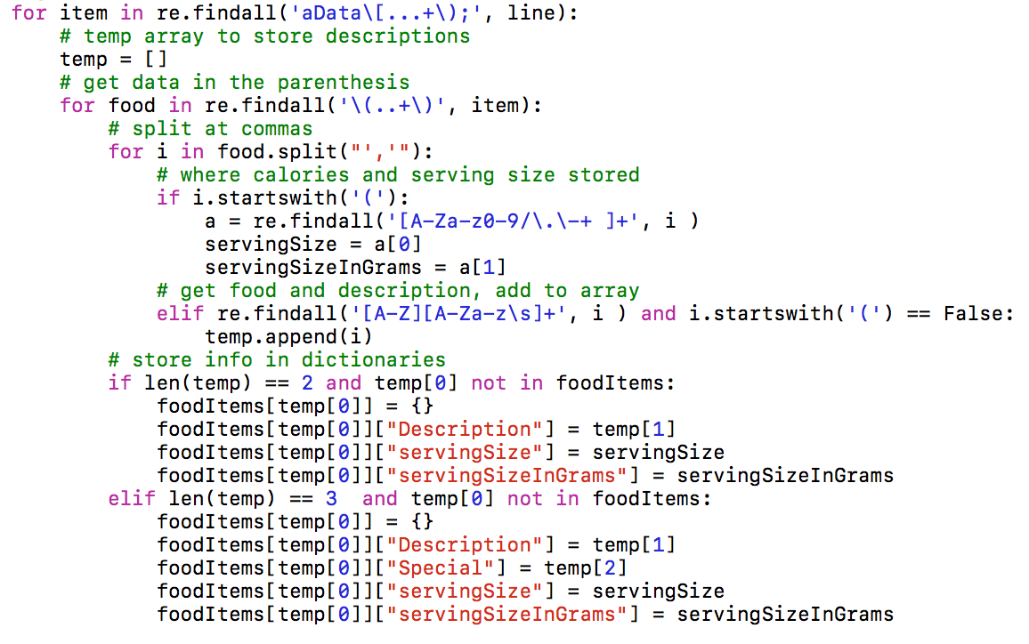
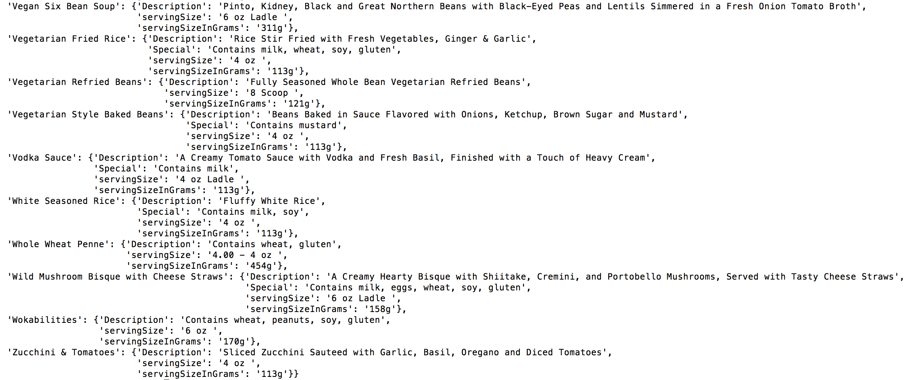
311 + 170 = 481

Slide 6


Demo: Calculating Total Calories with Xcode

Slide 7
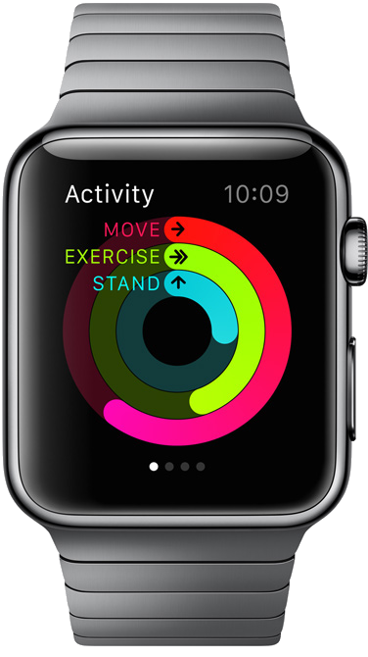
Issue: Motivation

Slide 8
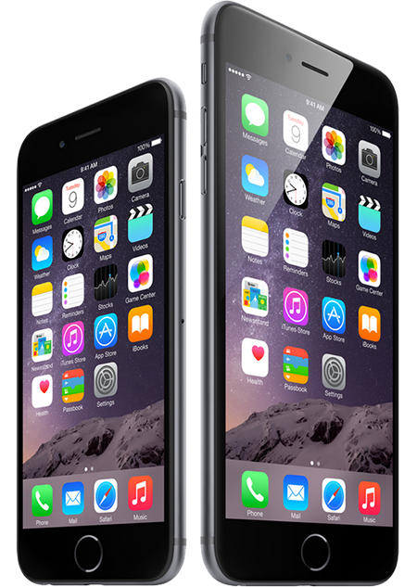
Technology

Slide 9
Questions

Slide 10
Sources
Animated Runner: http://www.animatedimages.org/img-animated-running-image-0041-191799.htm
Runner Road: https://www.highlandridgerv.com/assets/front-end/img/roadside-with-rail-tall.png
Motivation Sign: http://www.behappy101.com/images/motivation.png
Sky Background: http://www.corgan75.com/images/objects/1998-2008/terminal-d-SKY.png
Binary Code Video: https://pixabay.com/en/videos/matrix-numbers-green-data-block-5539/
Swift Logo: https://upload.wikimedia.org/wikipedia/commons/thumb/2/20/Swift_logo_with_text.svg/2000px-Swift_logo_with_text.svg.png
Fuelband Photo: http://www.expertreviews.co.uk/wearable-technology/fitness-equipment/1400500/nike-fuelband-se-review
Apple Watch: https://www.pinterest.com/sundyme/apple-watch/
Running Photo: http://silasmanhood.photoshelter.com/image/I0000JjpJxSKEAxA
iPhone Image: https://upload.wikimedia.org/wikipedia/commons/thumb/2/20/Swift_logo_with_text.svg/2000px-Swift_logo_with_text.svg.png
Xcode Image: https://upload.wikimedia.org/wikipedia/en/archive/0/0c/20161113035920!Xcode_icon.png
Accelerometer: http://www.now-instruments.com/images/phone_axes.png
Question Mark: https://img.clipartfox.com/c9fc29423e723f92811d4535d9fd2931_lol-question-markpng-questions-for-the-yellow-clipart_892-885.png
Question Joke: https://www.pinterest.com/pin/273945589804578144/
Challenge Quote: https://www.pinterest.com/bossdoss1/ec-exercise-planner-cover/
Programming Joke: http://www.webdevelopersnotes.com/joke-eat-sleep-code
Three Question: http://themes.muffingroup.com/doover/

